Slide 1



NAAC Accreditation
Accreditation Made Simple
Our core idea is to streamline the NAAC Data Validation and Verification process for educational institutions.
Addressing Challenges
This initiative stems from observing significant challenges within current NAAC accreditation procedures.

Slide 2




Problem Statement
Educational institutions frequently grapple with significant hurdles during the NAAC accreditation journey.
These challenges not only consume valuable resources but also introduce considerable stress.
Our platform directly addresses these pain points.
Labour-Intensive Manual Entries
Last-Minute Accreditation Stress
Dispersed Data Management
Difficulty in Tracking Metrics
Data and documentation are
fragmented and disorganized,
leading to inefficiencies.
Reliance on manual Excel workflows is slow, tedious, and highly susceptible to errors.
Colleges face significant costs from hiring external consultants for NAAC preparation.
The NAAC peer team visits are a source of immense stress and anxiety for staff.

Slide 3



Target Audience / Market
Our primary market includes all types of universities: Central, State, and Private institutions.
We also cater to Autonomous and Affiliated Colleges offering both Undergraduate (UG) and Postgraduate (PG) programs.
Key users within these institutions include IQAC Coordinators, College Administrators, and Faculty Members.

Slide 4



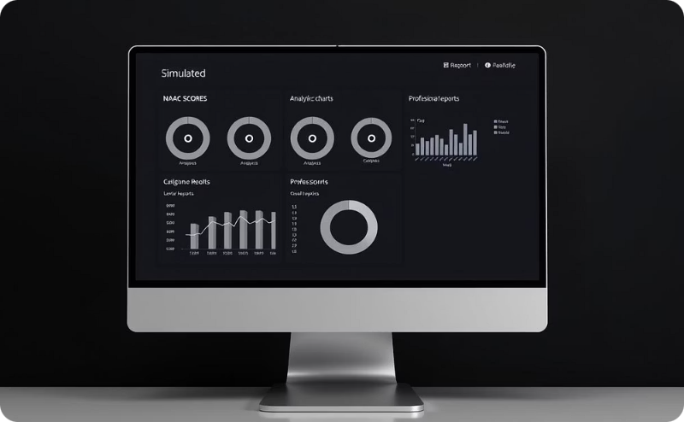
Proposed Solution
We propose a robust cloud-based SaaS platform specifically designed for seamless NAAC accreditation management.
Our "Digital Nest" feature centralizes all documentation, creating a single, accessible source of truth.
The platform automates data validation and intelligently maps content directly to NAAC accreditation requirements.
It simulates NAAC scores in real-time and generates comprehensive reports, simplifying the assessment process.

Slide 5
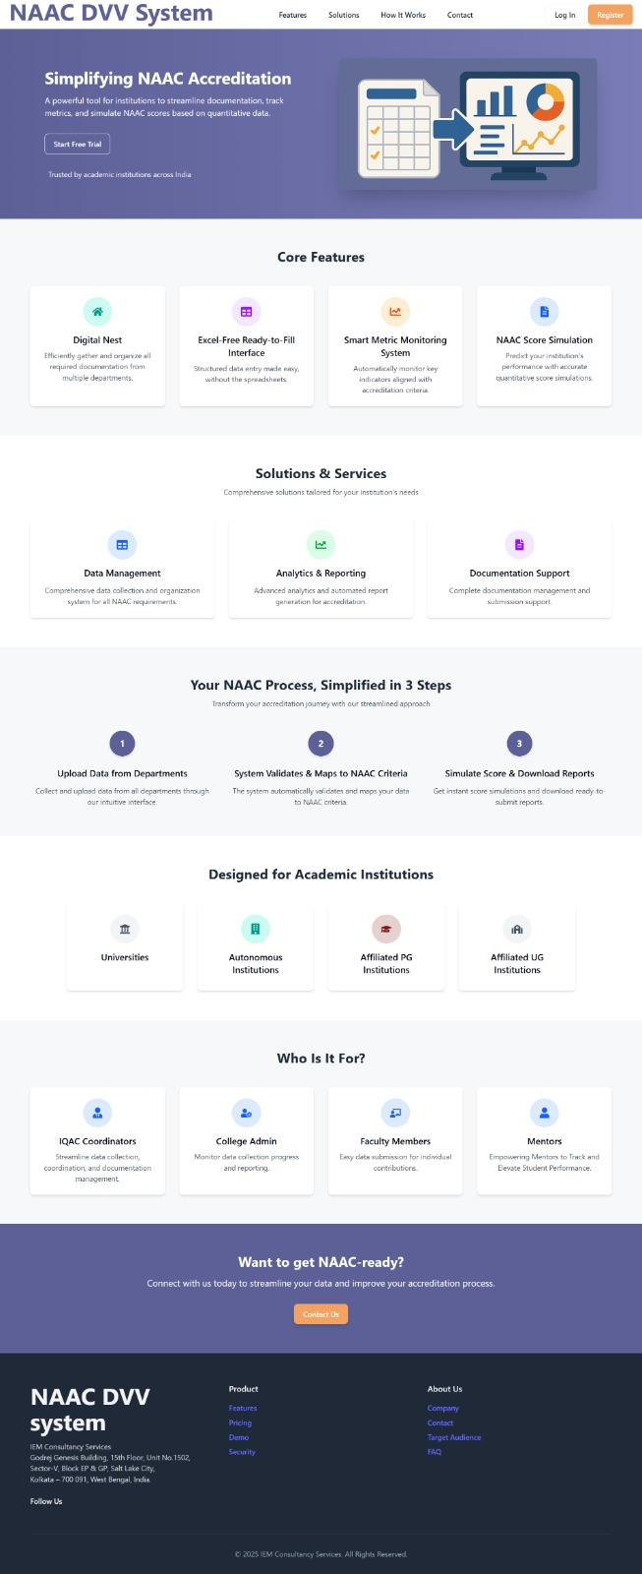
Landing Page:
Our landing page thoroughly summarizes the processes
and key factors we provide and a smooth portal to our
website

Slide 6
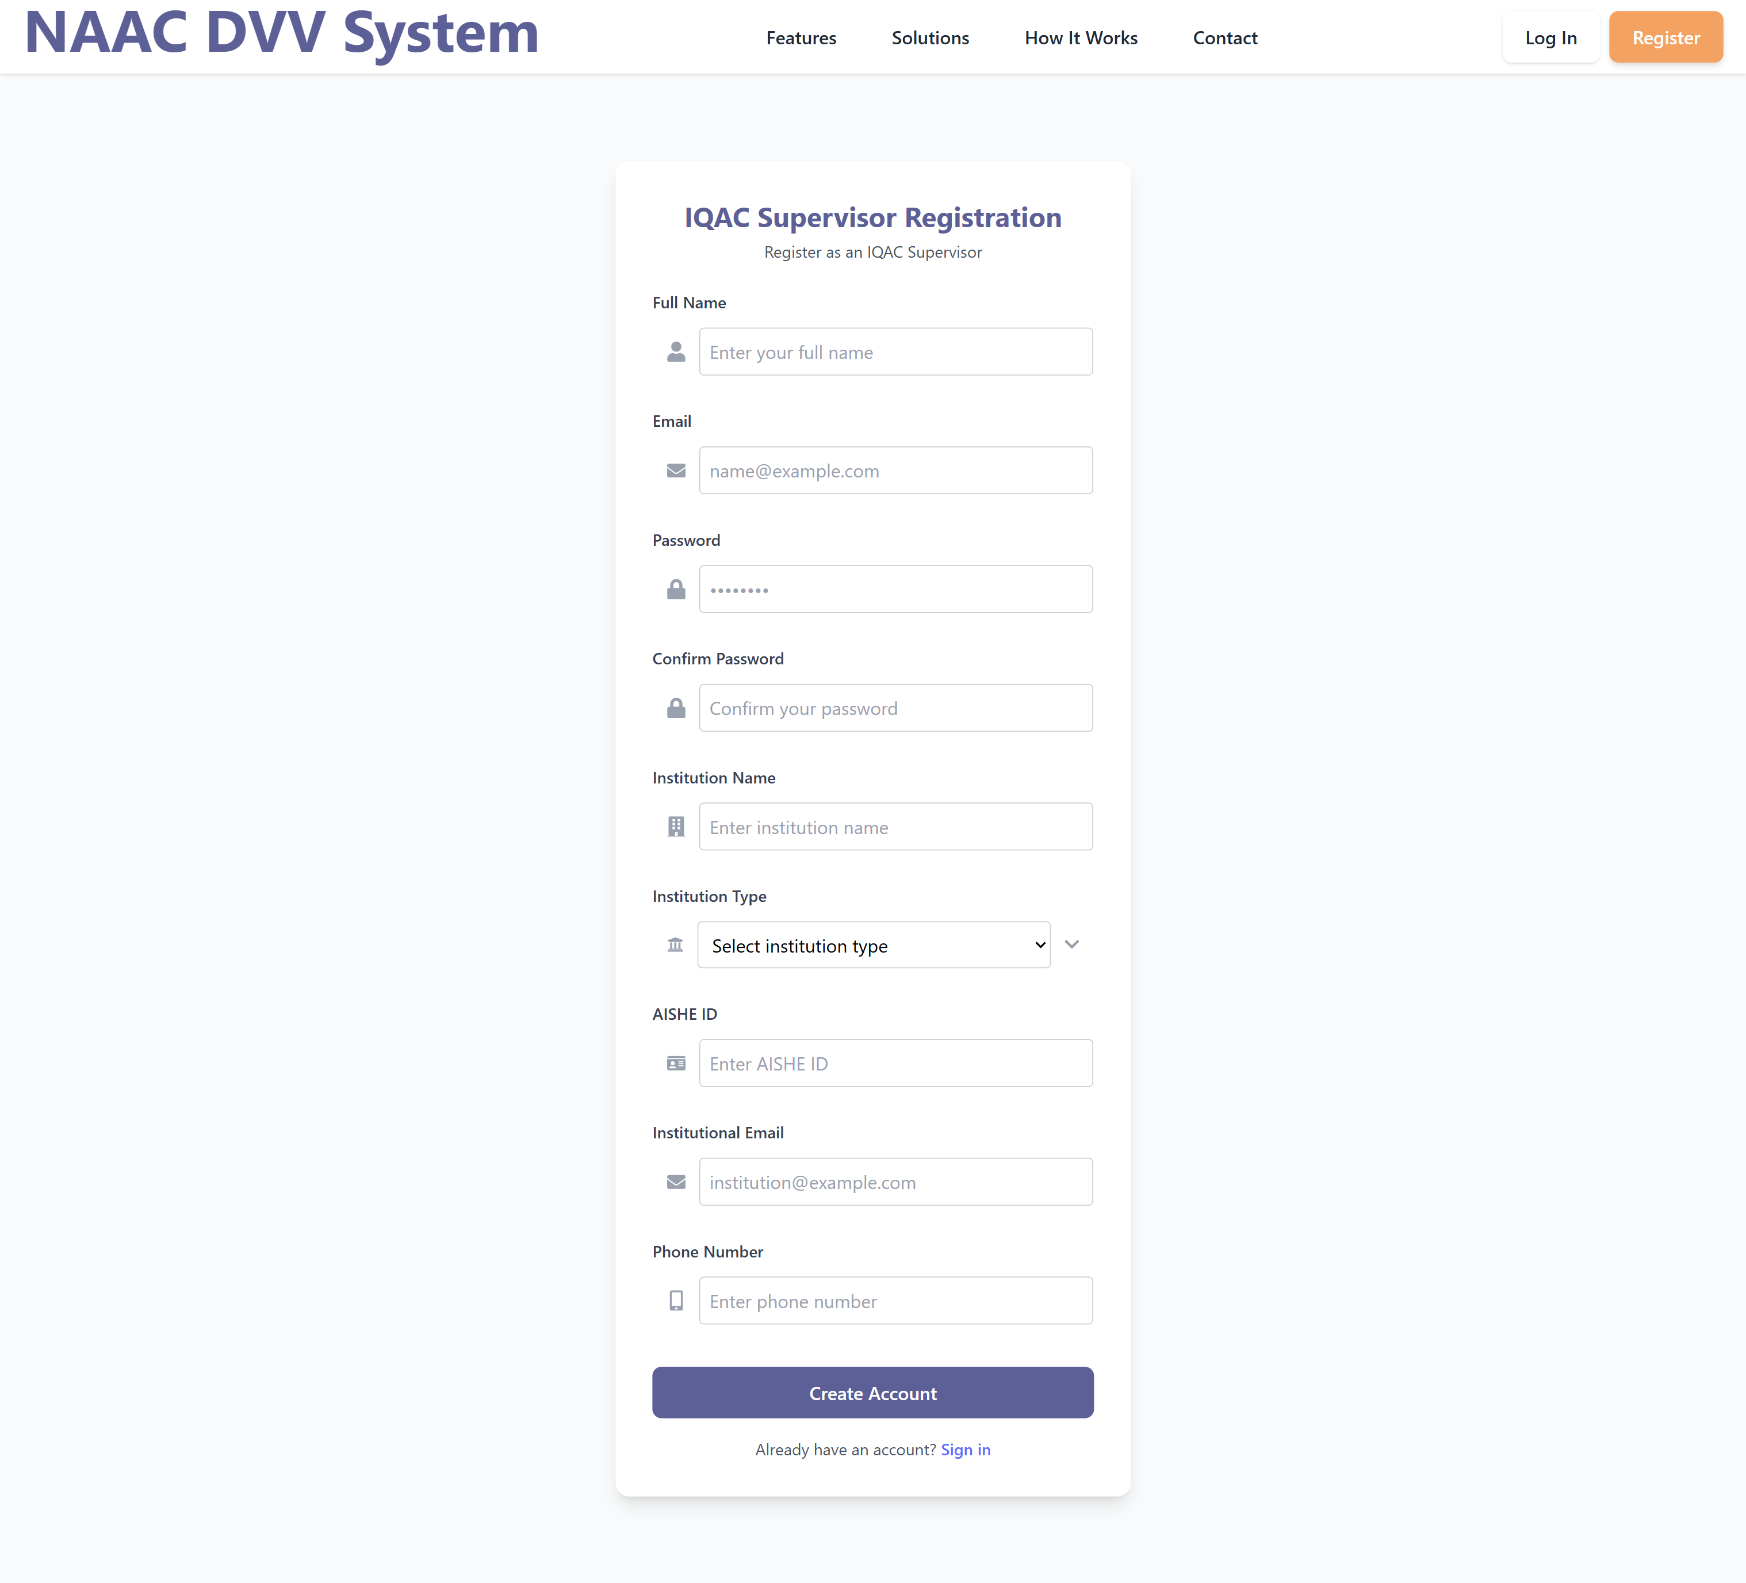
Registration Page
Each college is assigned there own
database Through their own unique
AISHE ID

Slide 7
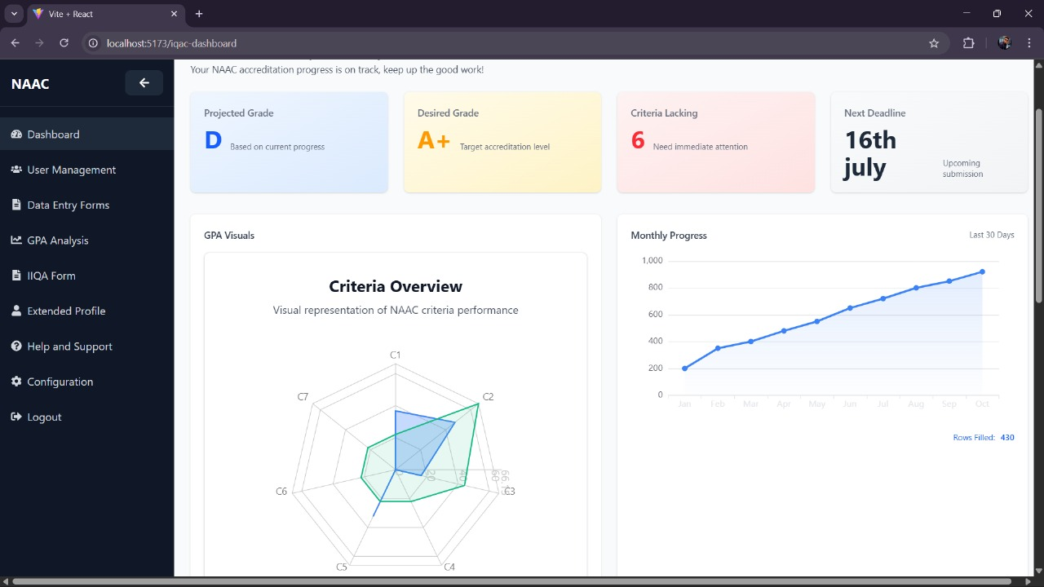
IQAC Dashboard :
The IQAC dashboard shows all
the briefs and the data overviews
in proper graphical and radial
formats

Slide 8
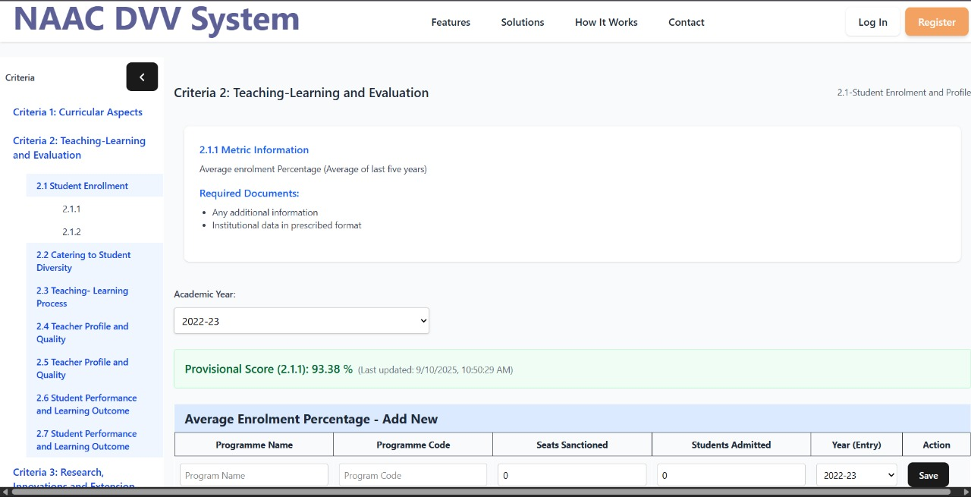
Data Upload – Faculty/Admin uploads
The data inputs are taken in a
very systematic and excel free
manner which allows the user to
have a hassle free and smooth
experience

Slide 9
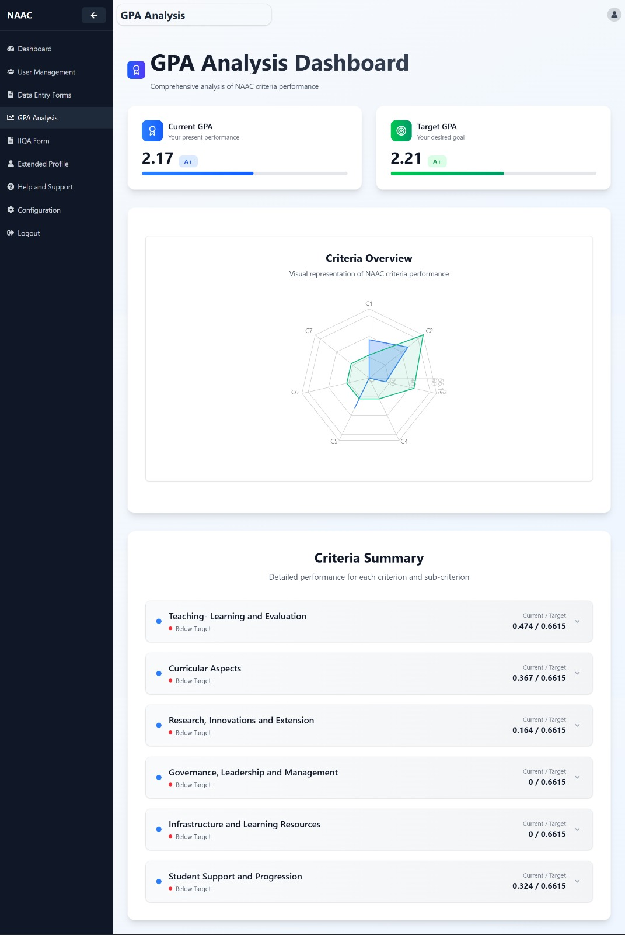
Score Simulation – Predict NAAC grade
Our intuitive gpa/grade analysis
system provides in depth and
reliable grades, and helps the user
Reach their desired grade

Slide 10
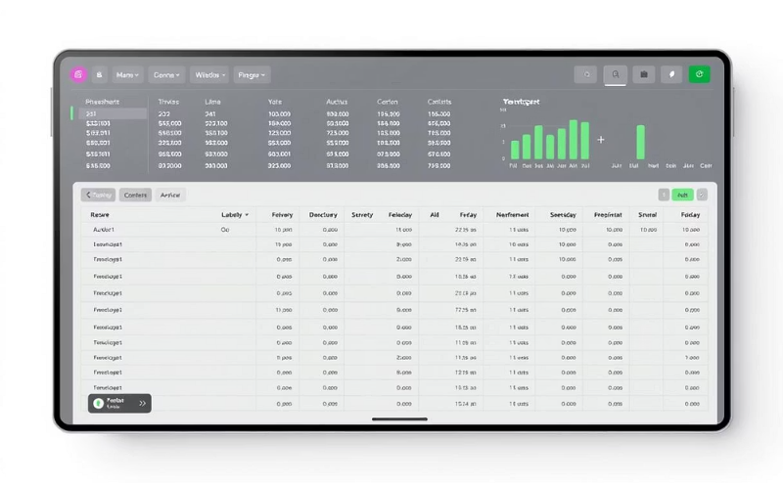

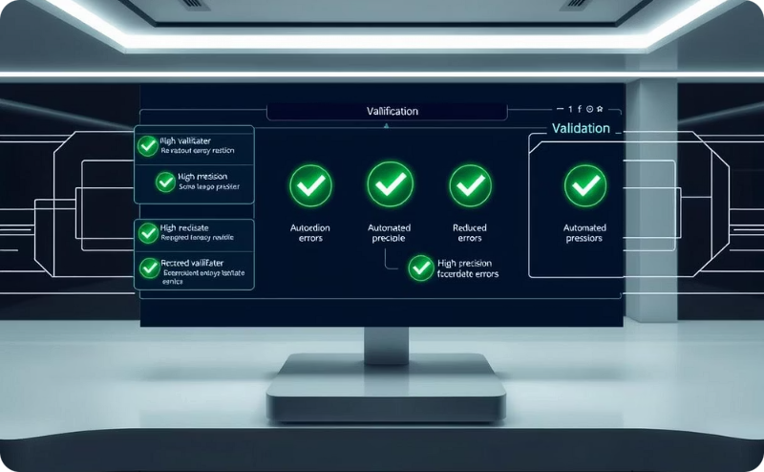

Value Proposition
Streamlined processes mean no complex Excel workflows, simplifying operations for all users.
Significant cost savings compared to expensive external consultancy services.
Automated validation ensures high accuracy and significantly reduces human errors.
We are yet to come across any other platforms who provide the same or anywhere near all the various services our platform provides, thus our platform is truly one of a kind, intuitive and unique.
Our platform recalibrates the scores and helps the user explore their gaps for improvement

Slide 11



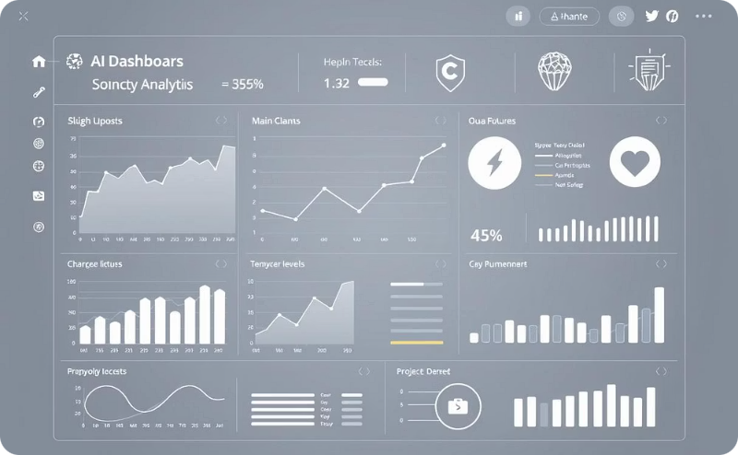
Business Model
Our model is a B2B SaaS subscription-based service, offering continuous value to educational institutions.
For small colleges, our annual subscription is priced at ₹XXXXX per year, making it accessible for institutions with limited budgets.
Large universities benefit from our comprehensive package at ₹XXXXX per year, scaled to meet the needs of extensive operations.
We offer exciting upsell opportunities including advanced analytics and AI-powered add-ons to further enhance value.

Slide 12
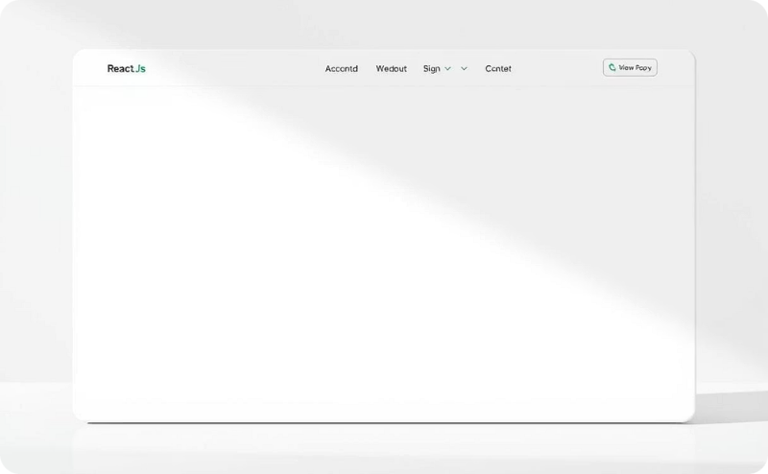
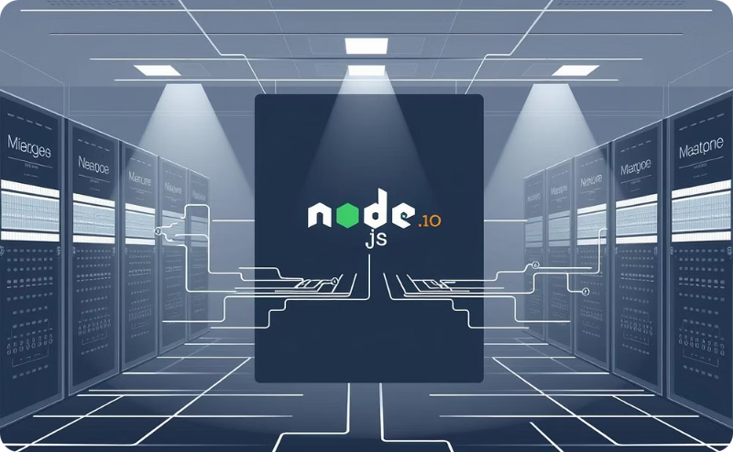

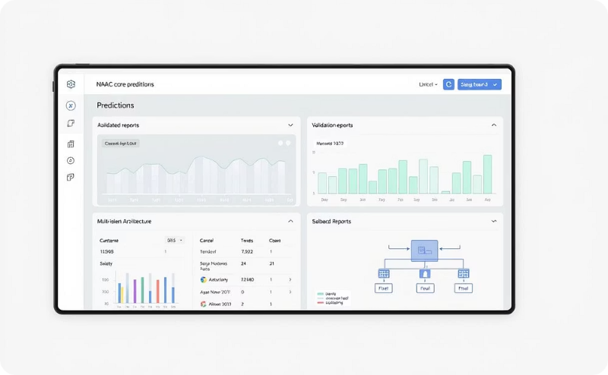
Technology / Innovation
Our frontend is powered by React.js, delivering a modern, responsive, and intuitive user interface.
Node.js and Express form our robust backend, coupled with MySQL for secure and efficient data management.
Hosted on leading cloud platforms like AWS/Azure, our solution ensures high scalability, reliability, and global access.
Key innovations include Score Simulation, Automated Validation, and a Multi-tenant SaaS architecture.

Slide 13





Technical Approach
Data Upload
Smart Validation
Secure Storage
Faculty and administrators securely upload raw data and documents to the platform.
Our backend system automatically validates the uploaded data and intelligently maps it to relevant NAAC criteria.
All processed data is securely stored in a robust MySQL database, ensuring data integrity and accessibility.
Score Simulation & Reporting
Download & Submission
The system simulates NAAC scores in real-time and generates comprehensive reports in PDF and Excel formats.
Authorized administrators and IQAC teams can easily download generated reports for review and final NAAC submission.

Slide 14


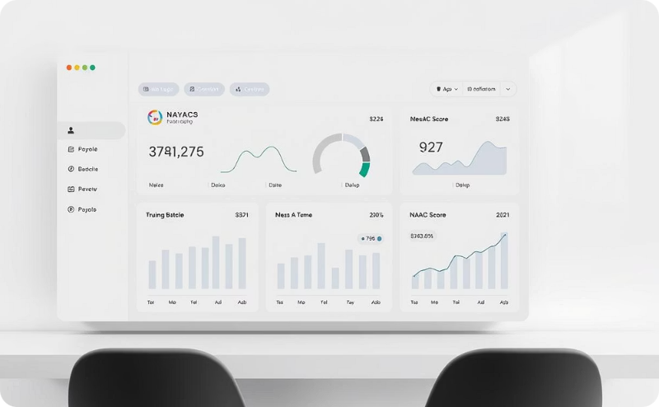

Product MVP
Data Upload & Validation
Report Generation
Score Simulation
Role-based Access
Generate comprehensive reports in both PDF and Excel formats, ready for immediate submission.
Predict your NAAC grade with real-time score simulation based on quantitative metrics.
Manage user permissions efficiently with specific access levels for administrators, faculty, and IQAC teams.
Seamlessly upload and validate all necessary data, ensuring accuracy and compliance for NAAC.
Looking ahead, our future roadmap includes AI-powered insights, seamless ERP/LMS integration, and a dedicated mobile application to enhance functionality.

Slide 15
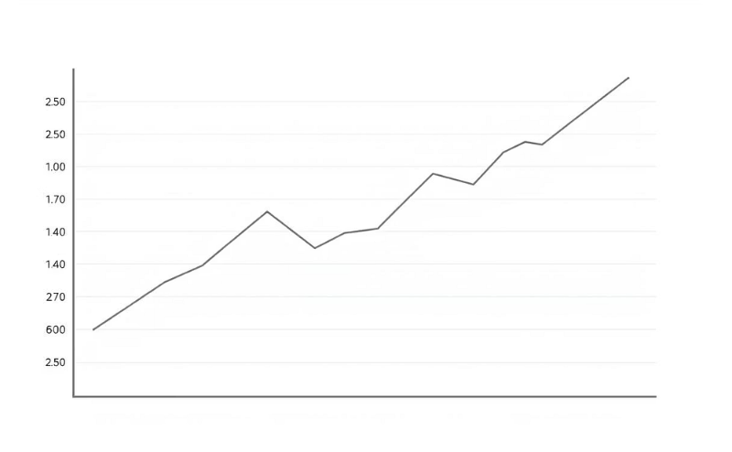
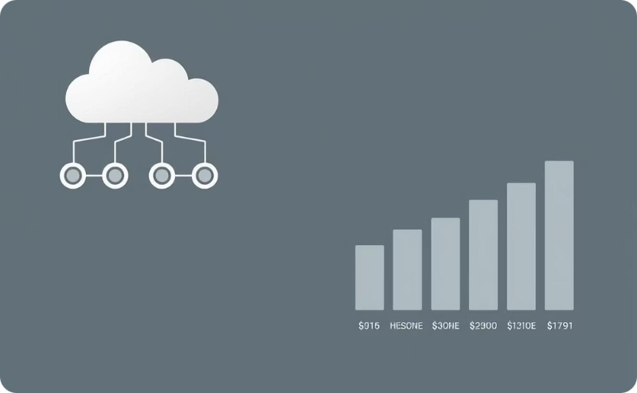
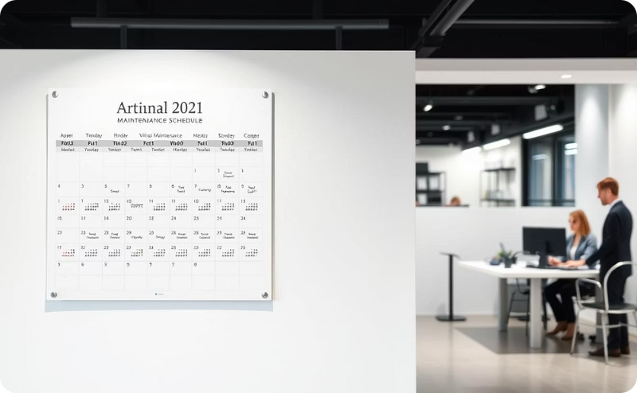
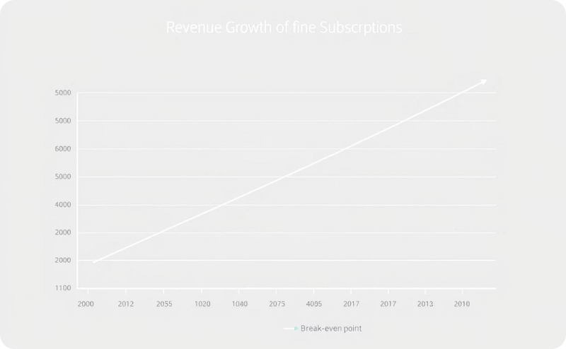
Budget
Software development requires an initial investment of ₹X-X Lakhs.
Ongoing cloud hosting and system maintenance costs ₹X-XXK monthly.
An annual maintenance fee of ₹XXK ensures continuous operation and support.
Our subscription-based revenue model projects breaking even with 20+ college clients.

Slide 16
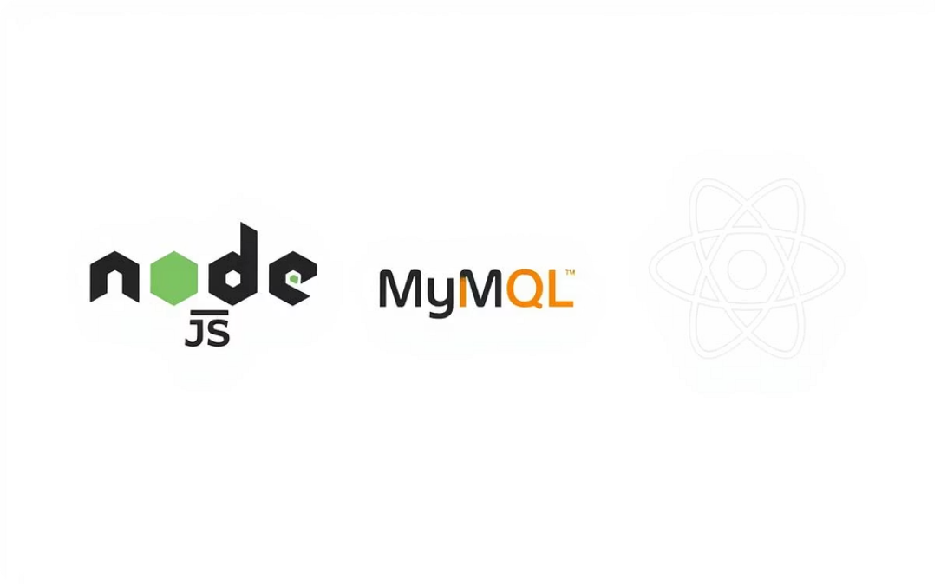


Implementation Feasibility
Our technical stack, including Node.js, MySQL, and React, is proven and robust, ensuring high technical feasibility.
Our team possesses comprehensive expertise in backend, frontend, and cloud technologies, guaranteeing strong development capability.
Colleges are already allocating significant resources for NAAC preparation, indicating a strong market readiness and adoption feasibility for our solution.

Slide 17



Potential Impact
Our solution significantly reduces the time spent on NAAC preparation, saving 1000+ man-hours per institution annually.
We provide an affordable solution specifically designed for Tier-2 and Tier-3 colleges, making accreditation accessible.
By boosting NAAC score readiness, our platform enhances institutional ranking and builds trust within the academic community.

Slide 18
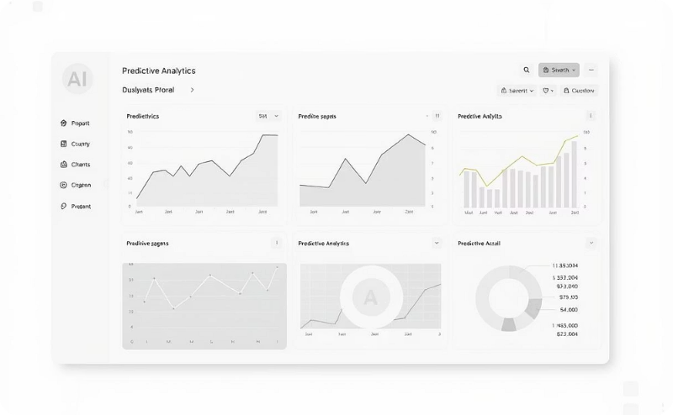

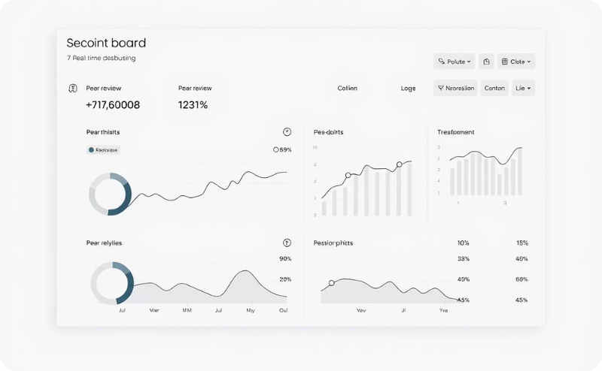
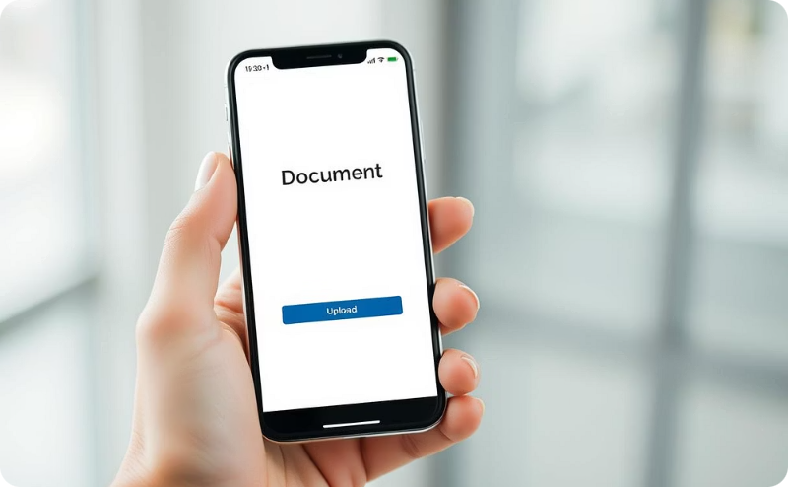
Future Scope
AI-driven predictive analytics for enhanced foresight.
Blockchain for secure document verification.
Real-time dashboards for streamlined peer reviews.
Mobile-first app for convenient faculty uploads.

Slide 19


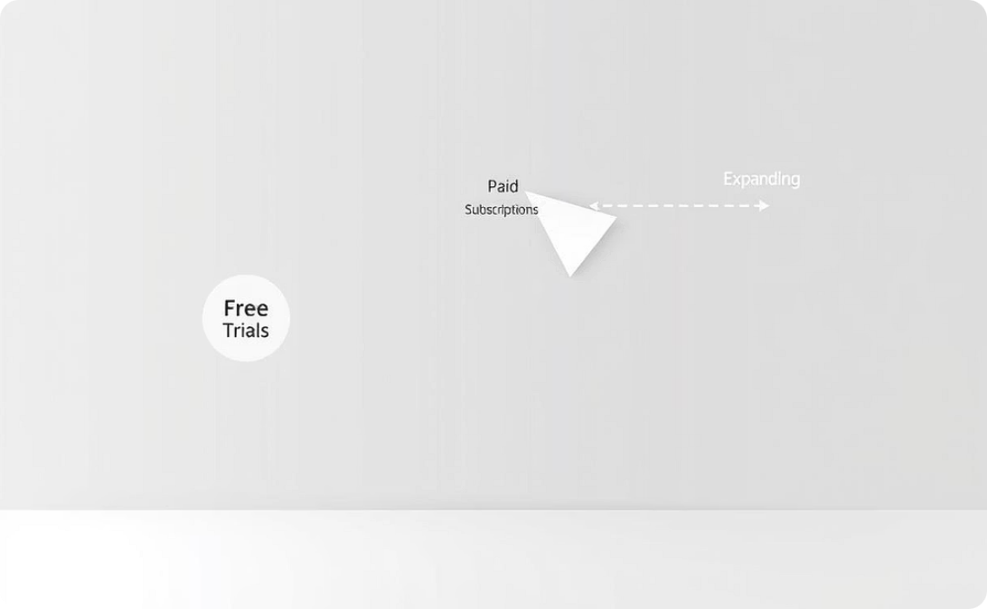
Marketing Plan
Our primary target audience includes a wide range of educational institutions, from universities to colleges.
We will utilize various channels, including educational conferences, strategic partnerships, and direct outreach to IQAC coordinators.
Our growth strategy progresses from offering free trials to converting users into paid subscriptions, and further expanding through strategic partnerships.

Slide 20
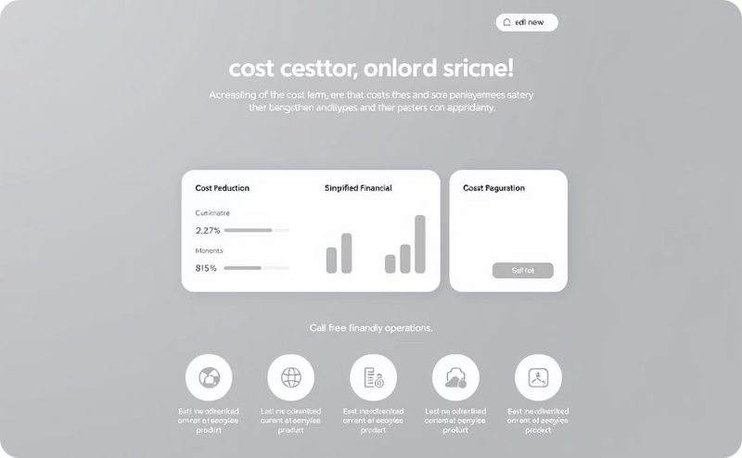



USP (Unique Selling Proposition)
Our platform offers unparalleled ease of use, leading to significant operational cost savings for institutions.
The system is uniquely designed and tailor-made to meet the specific requirements of NAAC accreditation.
Automated validation processes ensure high accuracy, drastically minimizing human errors.
As a scalable SaaS solution, our platform seamlessly accommodates both small colleges and large universities.

Slide 21
Competitors :
We are yet to come across any other platforms who provide the same or anywhere near all the various services our platform provides, thus our platform is truly one of a kind, intuitive and unique.

Slide 22
Team Members
1. Sankhadeep Chowdhury
5. Trishita Podder
Backend & Cloud (MySQL, AWS)
Backend & Strategy
6. Karan Jack
2. Tanit Ghosh
Frontend (React.js, UI/UX) & Strategy
Backend & testing
7. Samayita Ray
3. Sourick Banerjee
Database & Grading Logic
UI/UX
4. Sneha Pandey
Frontend & Backend

Slide 23

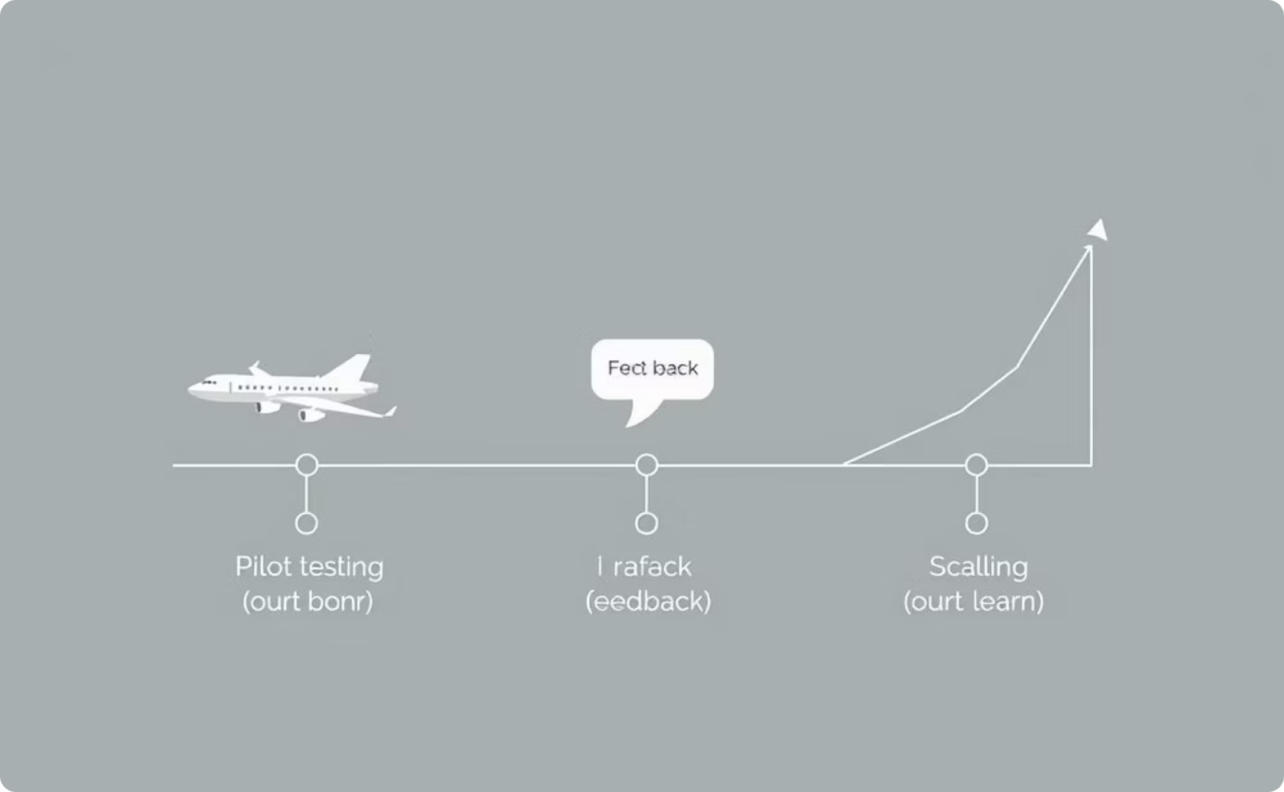
Status
Current Status
Next Steps
Our solution is currently in the prototype stage of development, focusing on the Minimum Viable Product (MVP) features.
Our immediate roadmap includes pilot testing, incorporating user feedback, and preparing for a scaled launch.

